Slide 1
Types of Data &
Data Preprocessing
Prof. Navneet Goyal
Department of Computer Science & Information Systems
BITS, Pilani

Slide 2
Topics
Types of Data
Statistical Description of Data
Measures of Similarity & Dissimilarity
Data Quality/Cleaning
Data Reduction
Data Transformation & Discretization

Slide 3

What is Data?
Attributes
Collection of data objects and their attributes
An attribute is a property or characteristic of an object
  Examples: eye color of a person, temperature, etc.
  Attribute is also known as variable, field, characteristic, or feature
A collection of attributes describe an object
  Object is also known as record, point, case, sample, entity, or instance
Objects
Text book slide

Slide 4
Types of Attributes
There are different types of attributes
  Nominal
    Examples: ID numbers, eye color, zip codes
  Ordinal
    Examples: rankings (e.g., taste of potato chips on a scale from 1-10), grades, height in {tall, medium, short}
  Interval
    Examples: calendar dates, temperatures in Celsius or Fahrenheit.
  Ratio
    Examples: temperature in Kelvin, length, time, counts
Text book slide

Slide 5
Discrete and Continuous Attributes
Discrete Attribute
  Has only a finite or countably infinite set of values
  Examples: zip codes, counts, or the set of words in a collection of documents
  Often represented as integer variables.
  Note: binary attributes are a special case of discrete attributes
Continuous Attribute
  Has real numbers as attribute values
  Examples: temperature, height, or weight.
  Practically, real values can only be measured and represented using a finite number of digits.
  Continuous attributes are typically represented as floating-point variables.
Text book slide

Slide 6
Types of data sets
Record
  Data Matrix
  Document Data
  Transaction Data
Graph
  World Wide Web
  Molecular Structures
Ordered
  Spatial Data
  Temporal Data
  Sequential Data
  Genetic Sequence Data
Text book slide

Slide 7
Record Data
Data that consists of a collection of records, each of which consists of a fixed set of attributes
Text book slide

Slide 8
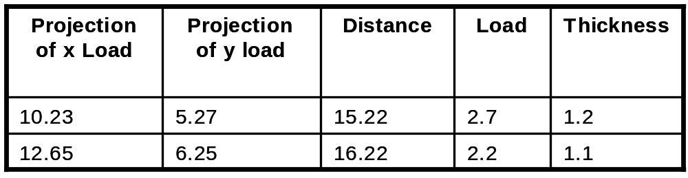
Data Matrix
If data objects have the same fixed set of numeric attributes, then the data objects can be thought of as points in a multi-dimensional space, where each dimension represents a distinct attribute
Such data set can be represented by an m by n matrix, where there are m rows, one for each object, and n columns, one for each attribute
Text book slide

Slide 9

Document Data
Each document becomes a `term' vector,
  each term is a component (attribute) of the vector,
  the value of each component is the number of times the corresponding term occurs in the document.
Text book slide

Slide 10

Transaction Data
A special type of record data, where
  each record (transaction) involves a set of items.
  For example, consider a grocery store. The set of products purchased by a customer during one shopping trip constitute a transaction, while the individual products that were purchased are the items.
Text book slide

Slide 11
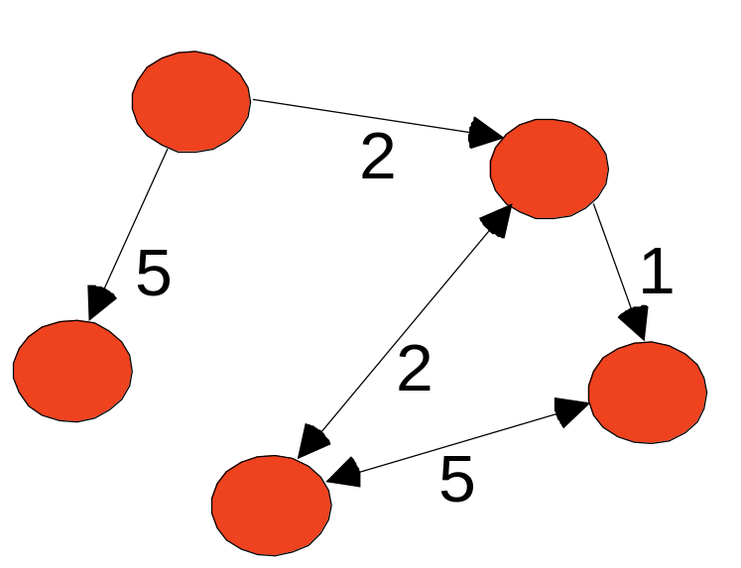
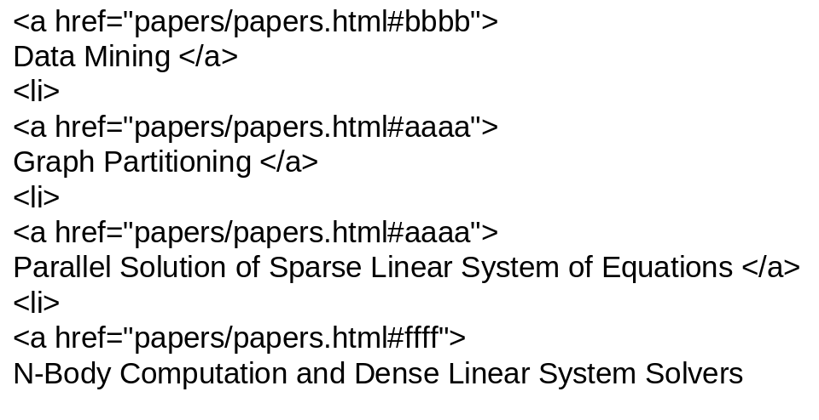
Graph Data
Examples: Generic graph and HTML Links
Text book slide

Slide 12
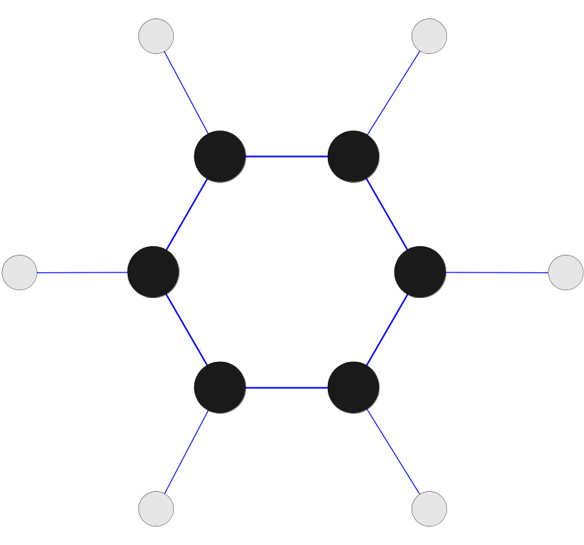
Chemical Data
Benzene Molecule: C₆H₆
Text book slide

Slide 13
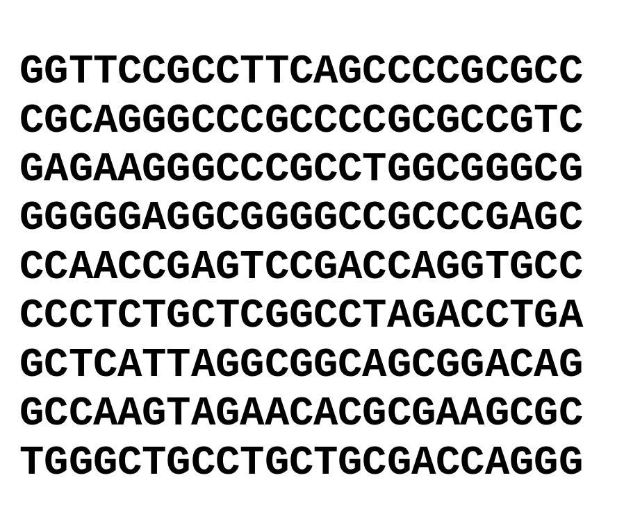
Ordered Data
Genomic sequence data
Text book slide

Slide 14
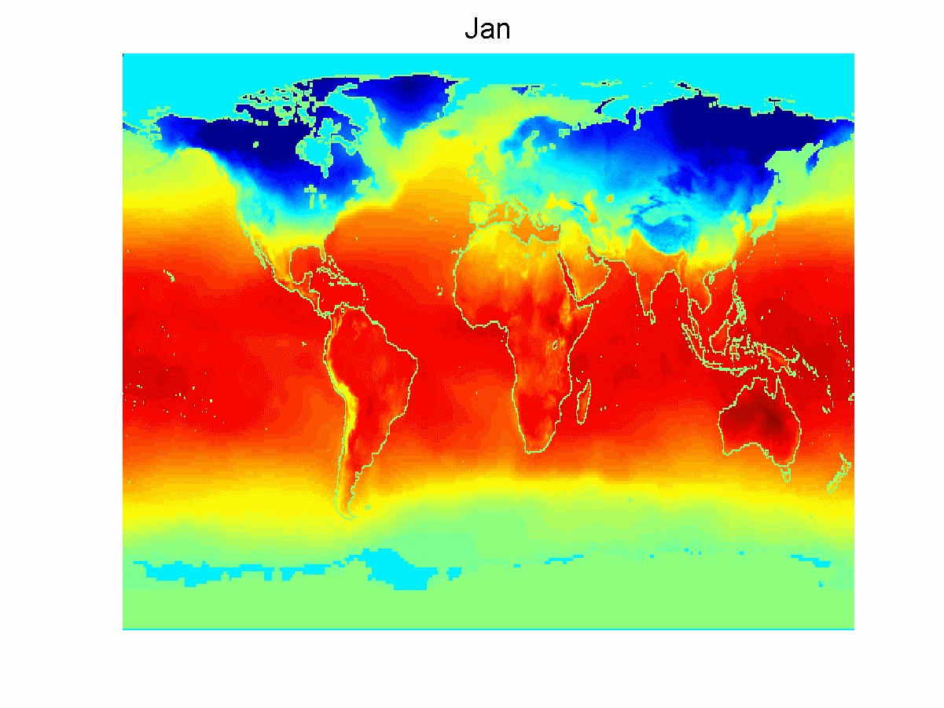
Ordered Data
Spatio-Temporal Data
Average Monthly Temperature of land and ocean
Text book slide

Slide 15
Data Quality
What kinds of data quality problems?
How can we detect problems with the data?
What can we do about these problems?
Examples of data quality problems:
  Noise and outliers
  missing values
  duplicate data
Text book slide

Slide 16


Noise
Noise refers to modification of original values
  Examples: distortion of a person’s voice when talking on a poor phone and “snow” on television screen
Two Sine Waves
Two Sine Waves + Noise
Text book slide

Slide 17

Outliers
Outliers are data objects with characteristics that are considerably different than most of the other data objects in the data set
Text book slide

Slide 18
Missing Values
Reasons for missing values
  Information is not collected
  (e.g., people decline to give their age and weight)
  Attributes may not be applicable to all cases
  (e.g., annual income is not applicable to children)
Handling missing values
  Eliminate Data Objects
  Estimate Missing Values
  Ignore the Missing Value During Analysis
  Replace with all possible values (weighted by their probabilities)
Text book slide

Slide 19
Missing Data
Data is not always available
  E.g., many tuples have no recorded value for several attributes, such as customer income in sales data
Missing data may be due to
  equipment malfunction
  inconsistent with other recorded data and thus deleted
  data not entered due to misunderstanding
  certain data may not be considered important at the time of entry
  not register history or changes of the data
Missing data may need to be inferred.

Slide 20
How to Handle Missing Data?
Ignore the tuple: usually done when class label is missing (assuming the tasks is classification—not effective when the percentage of missing values per attribute varies considerably)
Fill in the missing value manually: tedious + infeasible?
Use a global constant to fill in the missing value: e.g., “unknown”, a new class?!
Use the attribute mean to fill in the missing value
Use the attribute mean for all samples belonging to the same class to fill in the missing value: smarter
Use the most probable value to fill in the missing value: inference-based such as Bayesian formula or decision tree

Slide 21
Duplicate Data
Data set may include data objects that are duplicates, or almost duplicates of one another
  Major issue when merging data from heterogeous sources
Examples:
  Same person with multiple email addresses
Data cleaning
  Process of dealing with duplicate data issues
Text book slide

Slide 22
Data Preprocessing
Aggregation
Sampling
Dimensionality Reduction
Feature subset selection
Feature creation
Discretization and Binarization
Attribute Transformation
Text book slide

Slide 23
Aggregation
Combining two or more attributes (or objects) into a single attribute (or object)
Purpose
  Data reduction
    Reduce the number of attributes or objects
  Change of scale
    Cities aggregated into regions, states, countries, etc
  More “stable” data
    Aggregated data tends to have less variability
Text book slide

Slide 24
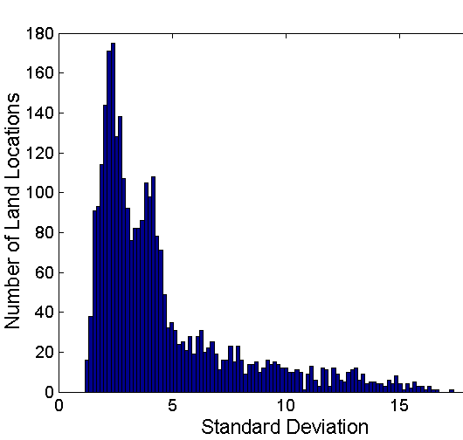
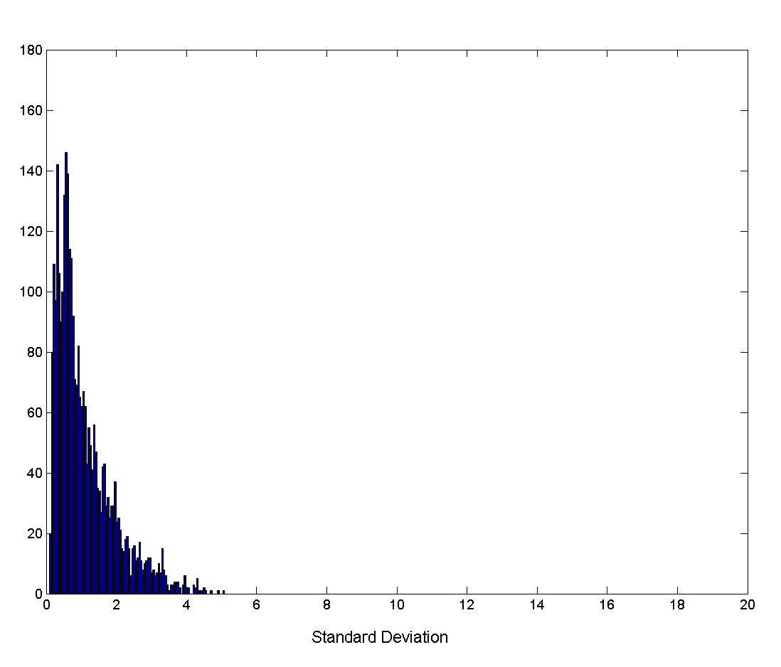
Aggregation
Variation of Precipitation in Australia
Standard Deviation of Average Monthly Precipitation
Standard Deviation of Average Yearly Precipitation
Text book slide

Slide 25
Sampling
Sampling is the main technique employed for data selection.
  It is often used for both the preliminary investigation of the data and the final data analysis.
Statisticians sample because obtaining the entire set of data of interest is too expensive or time consuming.
Sampling is used in data mining because processing the entire set of data of interest is too expensive or time consuming.
BIG DATA!!
Text book slide

Slide 26
Sampling …
The key principle for effective sampling is the following:
  using a sample will work almost as well as using the entire data sets, if the sample is representative
  A sample is representative if it has approximately the same property (of interest) as the original set of data
Text book slide

Slide 27
Types of Sampling
Simple Random Sampling
  There is an equal probability of selecting any particular item
Sampling without replacement
  As each item is selected, it is removed from the population
Sampling with replacement
  Objects are not removed from the population as they are selected for the sample.
    In sampling with replacement, the same object can be picked up more than once
Stratified sampling
  Split the data into several partitions; then draw random samples from each partition
Text book slide

Slide 28

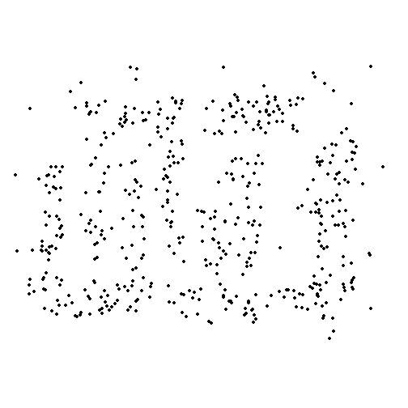
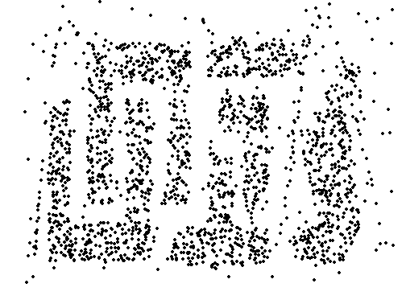
Sample Size
8000 points 2000 Points 500 Points
Text book slide

Slide 29
CoD & Dimensionality Reduction
Purpose:
  Avoid curse of dimensionality
  Reduce amount of time and memory required by data mining algorithms
  Allow data to be more easily visualized
  May help to eliminate irrelevant features or reduce noise
Techniques
  Principle Component Analysis (later)
  Singular Value Decomposition (later)
  Others: supervised and non-linear techniques
Text book slide

Slide 30
Dimensionality Reduction: PCA
Goal is to find a projection that captures the largest amount of variation in data
x₂
e
x₁
Text book slide

Slide 31
Dimensionality Reduction: PCA
Find the eigenvectors of the covariance matrix
The eigenvectors define the new space
x₂
e
x₁
Text book slide

Slide 32
Principal Component Analysis
X2
Y1
Y2
X1
Figure taken from Han & kamber Book: Data Mining Concepts & Techniques, 2e

Slide 33
Feature Subset Selection
Another way to reduce dimensionality of data
Redundant features
  duplicate much or all of the information contained in one or more other attributes
  Example: purchase price of a product and the amount of sales tax paid
Irrelevant features
  contain no information that is useful for the data mining task at hand
  Example: students' ID is often irrelevant to the task of predicting students' GPA
Text book slide

Slide 34
Feature Subset Selection
Techniques:
  Brute-force approch:
    Try all possible feature subsets as input to data mining algorithm
  Embedded approaches:
    Feature selection occurs naturally as part of the data mining algorithm
  Filter approaches:
    Features are selected before data mining algorithm is run
  Wrapper approaches:
    Use the data mining algorithm as a black box to find best subset of attributes
Text book slide

Slide 35
Feature Creation
Create new attributes that can capture the important information in a data set much more efficiently than the original attributes
Three general methodologies:
  Feature Extraction
    domain-specific
  Mapping Data to New Space
  Feature Construction
    combining features
Text book slide

Slide 36

Mapping Data to a New Space
Fourier transform
Wavelet transform
Two Sine Waves
Two Sine Waves + Noise
Frequency
Text book slide

Slide 37
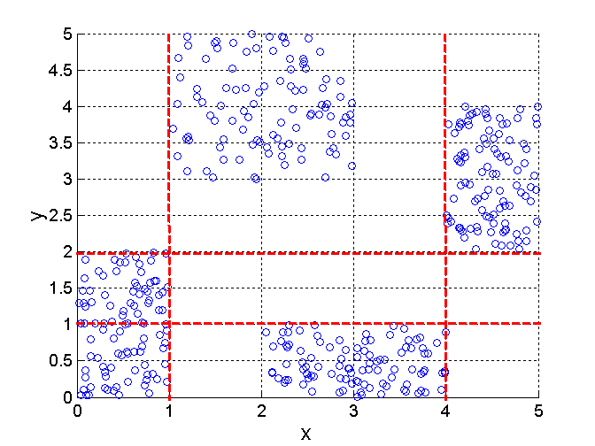
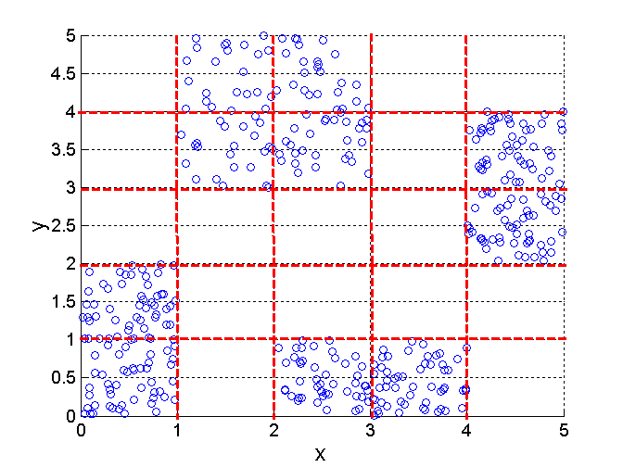
Discretization Using Class Labels
Entropy based approach
3 categories for both x and y
5 categories for both x and y
Text book slide

Slide 38




Discretization Without Using Class Labels
Data
Equal interval width
Equal frequency
K-means
Text book slide

Slide 39
Similarity and Dissimilarity
Similarity
  Numerical measure of how alike two data objects are.
  Is higher when objects are more alike.
  Often falls in the range [0,1]
Dissimilarity
  Numerical measure of how different are two data objects
  Lower when objects are more alike
  Minimum dissimilarity is often 0
  Upper limit varies
Proximity refers to a similarity or dissimilarity
Text book slide

Slide 40
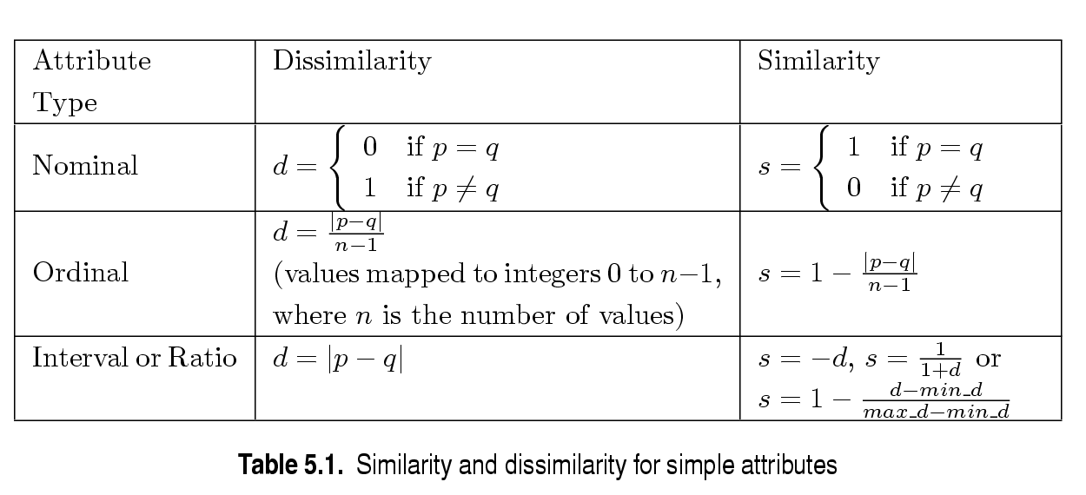
Similarity/Dissimilarity for Simple Attributes
p and q are the attribute values for two data objects.
Text book slide

Slide 41
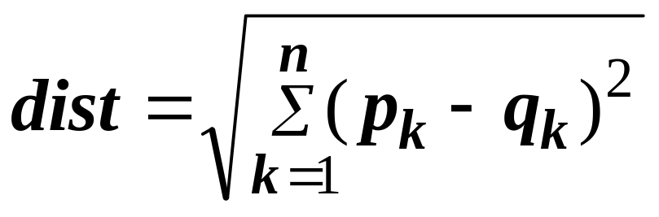
Euclidean Distance
Euclidean Distance
  Where n is the number of dimensions (attributes) and p_{k} and q_{k} are, respectively, the k^{th} attributes (components) or data objects p and q.
Standardization is necessary, if scales differ.
Text book slide

Slide 42
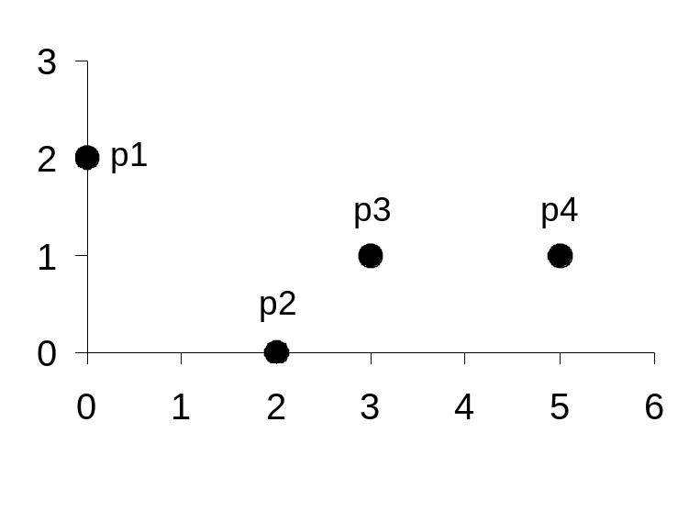
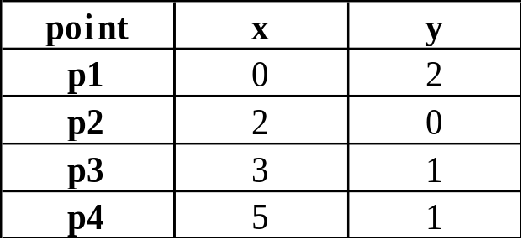
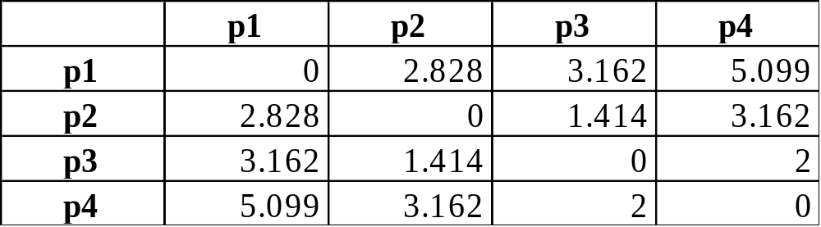
Euclidean Distance
Distance Matrix
Text book slide

Slide 43
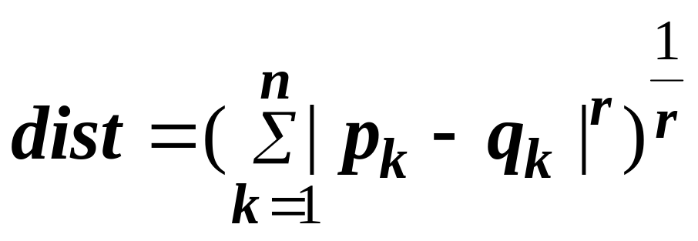
Minkowski Distance
Minkowski Distance is a generalization of Euclidean Distance
  Where r is a parameter, n is the number of dimensions (attributes) and p_{k} and q_{k} are, respectively, the kth attributes (components) or data objects p and q.
Text book slide

Slide 44
Minkowski Distance: Examples
r = 1. City block (Manhattan, taxicab, L₁ norm) distance.
  A common example of this is the Hamming distance, which is just the number of bits that are different between two binary vectors
r = 2. Euclidean distance
r → ∞. “supremum” (L_{max} norm, L∞ norm) distance.
  This is the maximum difference between any component of the vectors
Do not confuse r with n, i.e., all these distances are defined for all numbers of dimensions.
Text book slide

Slide 45
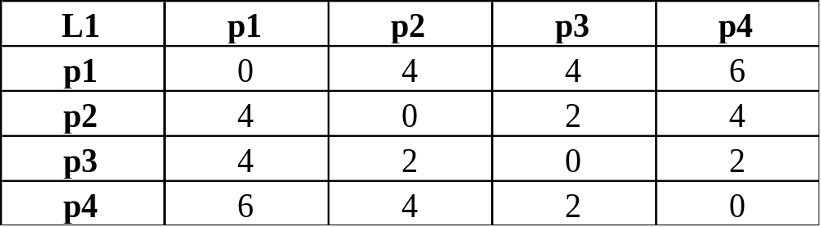
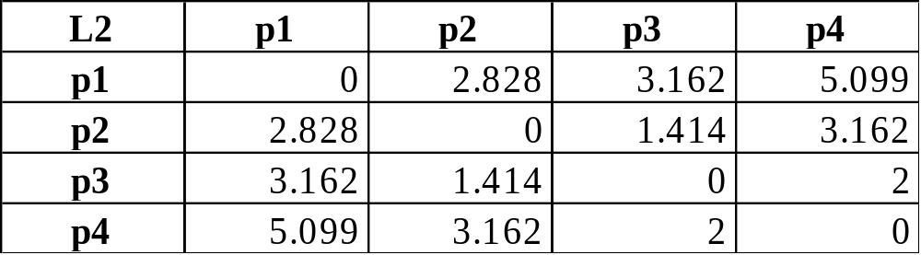
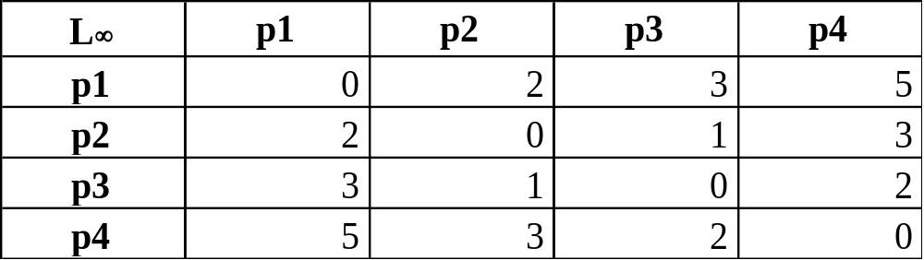
Minkowski Distance
Distance Matrix
Text book slide

Slide 46
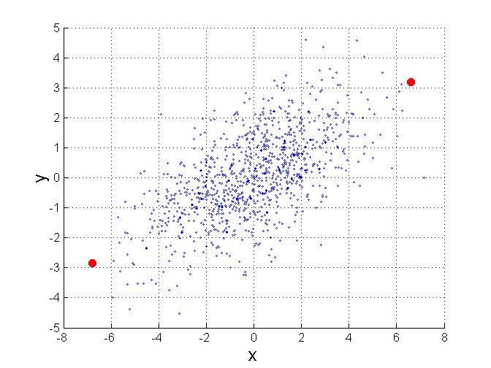
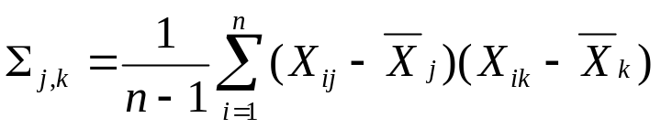
Mahalanobis Distance
Σ is the covariance matrix of the input data X
For red points, the Euclidean distance is 14.7, Mahalanobis distance is 6.
Text book slide

Slide 47
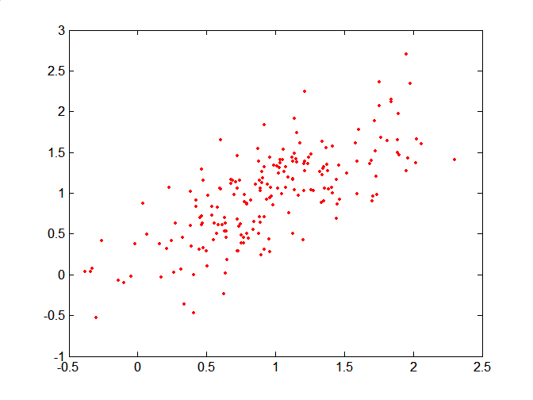
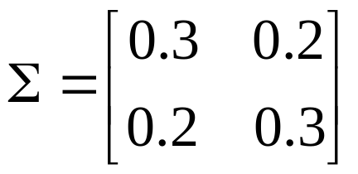
Mahalanobis Distance
Covariance Matrix:
C
B
A: (0.5, 0.5)
B: (0, 1)
C: (1.5, 1.5)
Mahal(A,B) = 5
Mahal(A,C) = 4
A
Text book slide

Slide 48
Common Properties of a Distance
Distances, such as the Euclidean distance, have some well known properties.
  d(p, q) ≥ 0 for all p and q and d(p, q) = 0 only if
  p = q. (Positive definiteness)
  d(p, q) = d(q, p) for all p and q. (Symmetry)
  d(p, r) ≤ d(p, q) + d(q, r) for all points p, q, and r.
  (Triangle Inequality)
where d(p, q) is the distance (dissimilarity) between points (data objects), p and q.
A distance that satisfies these properties is a metric
Text book slide

Slide 49
Common Properties of a Similarity
Similarities, also have some well known properties.
  s(p, q) = 1 (or maximum similarity) only if p = q.
  s(p, q) = s(q, p) for all p and q. (Symmetry)
where s(p, q) is the similarity between points (data objects), p and q.
Text book slide

Slide 50
Similarity Between Binary Vectors
Common situation is that objects, p and q, have only binary attributes
Compute similarities using the following quantities
M₀₁ = the number of attributes where p was 0 and q was 1
M₁₀ = the number of attributes where p was 1 and q was 0
M₀₀ = the number of attributes where p was 0 and q was 0
M₁₁ = the number of attributes where p was 1 and q was 1
Simple Matching and Jaccard Coefficients
SMC = number of matches / number of attributes
= (M₁₁ + M₀₀) / (M₀₁ + M₁₀ + M₁₁ + M₀₀)
J = number of 11 matches / number of not-both-zero attributes values
= (M₁₁) / (M₀₁ + M₁₀ + M₁₁)
Text book slide

Slide 51
SMC versus Jaccard: Example
p = 1 0 0 0 0 0 0 0 0 0
q = 0 0 0 0 0 0 1 0 0 1
M₀₁ = 2 (the number of attributes where p was 0 and q was 1)
M₁₀ = 1 (the number of attributes where p was 1 and q was 0)
M₀₀ = 7 (the number of attributes where p was 0 and q was 0)
M₁₁ = 0 (the number of attributes where p was 1 and q was 1)
SMC = (M₁₁ + M₀₀)/(M₀₁ + M₁₀ + M₁₁ + M₀₀) = (0+7) / (2+1+0+7) = 0.7
J = (M₁₁) / (M₀₁ + M₁₀ + M₁₁) = 0 / (2 + 1 + 0) = 0
Text book slide

Slide 52
Cosine Similarity
If d₁ and d₂ are two document vectors, then
cos( d₁, d₂ ) = (d₁ • d₂) / ||d₁|| ||d₂|| ,
where • indicates vector dot product and || d || is the length of vector d.
Example:
d₁ = 3 2 0 5 0 0 0 2 0 0
d₂ = 1 0 0 0 0 0 0 1 0 2
d₁ • d₂= 3*1 + 2*0 + 0*0 + 5*0 + 0*0 + 0*0 + 0*0 + 2*1 + 0*0 + 0*2 = 5
||d₁|| = (3*3+2*2+0*0+5*5+0*0+0*0+0*0+2*2+0*0+0*0)^{0.5} = (42) ^{0.5} = 6.481
||d₂|| = (1*1+0*0+0*0+0*0+0*0+0*0+0*0+1*1+0*0+2*2) ^{0.5} = (6) ^{0.5} = 2.245
cos( d₁, d₂ ) = .3150
Text book slide

Slide 53
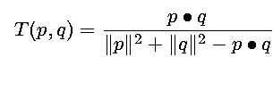
Extended Jaccard Coefficient (Tanimoto)
Variation of Jaccard for continuous or count attributes
  Reduces to Jaccard for binary attributes
Text book slide

Slide 54

Forms of data preprocessing
Figure taken from Han & kamber Book: Data Mining Concepts & Techniques, 2e

Slide 55
Data Transformation
Smoothing: remove noise from data
Aggregation: summarization, data cube construction
Generalization: concept hierarchy climbing
Normalization: scaled to fall within a small, specified range
  min-max normalization
  z-score normalization
  normalization by decimal scaling
Attribute/feature construction
  New attributes constructed from the given ones

Slide 56




Data Transformation: Normalization
min-max normalization
z-score normalization (zero-mean)
normalization by decimal scaling
Where j is the smallest integer such that Max(| |)<1

